Slide 1
Operating Systems and Systems Programming
Deadlock

Slide 2
The Content is prepared with the help of existing text books mentioned below:
References:
Silberschatz, Abraham, Peter B. Galvin, and Greg Gagne. Operating system concepts with Java. Wiley Publishing, 2009.
Stallings, William. Operating Systems 5th Edition. Pearson Education India, 2006.
Tannenbaum, Andrew S. "Modern Operating Systems, 2009."

Slide 3
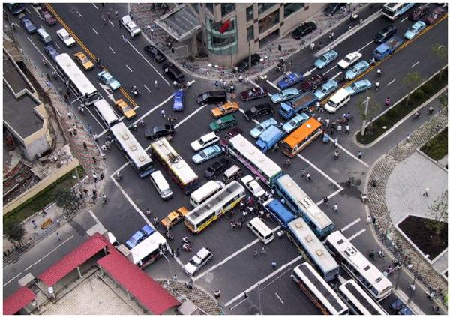
Deadlock

Slide 4
Resources
System consists of resources
Resource types R₁, R₂, . . ., R_{m}
CPU cycles, memory space, I/O devices
Each resource type R_{i} has W_{i} instances.
Each process utilizes a resource as follows:
request
use
release

Slide 5
Resources
Preemptable resources
can be taken away from a process with no ill effects
Non-preemptable resources
will cause the process to fail if taken away

Slide 6
Resources
Sequence of events required to use a resource
request the resource
use the resource
release the resource
Must wait if request is denied
requesting process may be blocked
may fail with error code

Slide 7
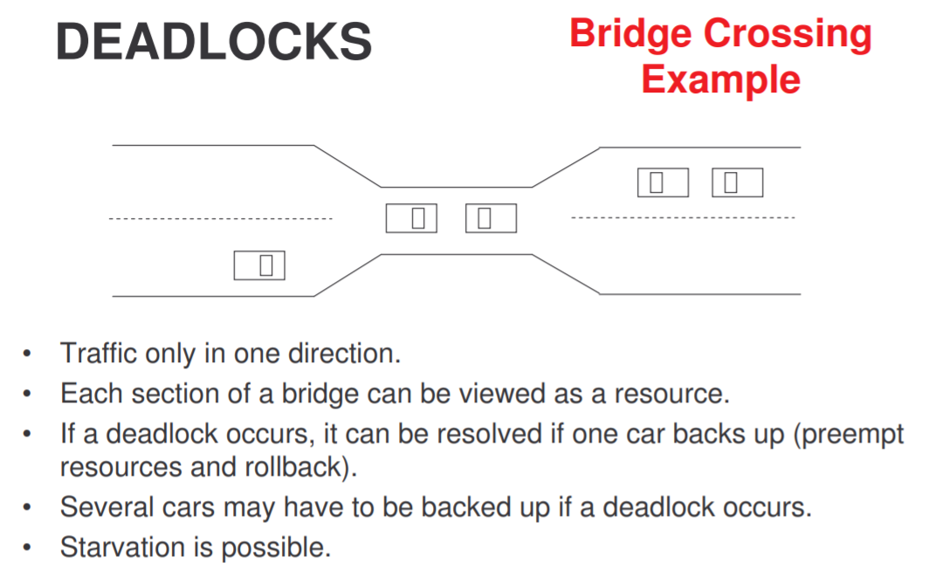

Slide 8
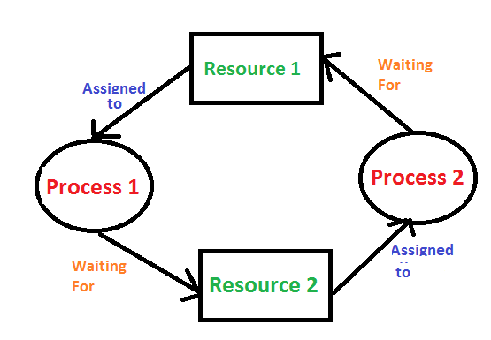
The Deadlock problem
In a computer system deadlocks arise when members of a group of processes which hold resources are blocked indefinitely from access to resources held by other processes within the group.

Slide 9
When do deadlocks happen?
Suppose
Process 1 holds resource A and requests resource B
Process 2 holds B and requests A
Both can be blocked, with neither able to proceed
Deadlocks occur when …
Processes are granted exclusive access to devices or software constructs (resources)
Each deadlocked process needs a resource held by another deadlocked process
Process 1
Process 2
A
B
A
B
DEADLOCK!

Slide 10
What is a deadlock?
Formal definition: “A set of processes is deadlocked if each process in the set is waiting for an event that only another process in the set can cause.”
Usually, the event is release of a currently held resource
In deadlock, none of the processes can
Run
Release resources
Be awakened

Slide 11
Deadlock with Semaphores
Data:
A semaphore S1 initialized to 1
A semaphore S2 initialized to 1
Two processes P1 and P2
P1:
wait(s1)
wait(s2)
P2:
wait(s2)
wait(s1)

Slide 12
Four Conditions for Deadlock
Mutual exclusion condition
each resource assigned to 1 process or is available
Hold and wait condition
process holding resources can request additional
No preemption condition
previously granted resources cannot forcibly taken away
Circular wait condition
must be a circular chain of 2 or more processes
each is waiting for resource held by next member of the chain

Slide 13
Four Conditions for Deadlock
Mutual exclusion condition
each resource assigned to 1 process or is available
Hold and wait condition
process holding resources can request additional
No preemption condition
previously granted resources cannot forcibly taken away
Circular wait condition
must be a circular chain of 2 or more processes
each is waiting for resource held by next member of the chain

Slide 14
Resource-Allocation Graph
A set of vertices V and a set of edges E.
V is partitioned into two types:
P = {P₁, P₂, …, P_{n}}, the set consisting of all the processes in the system
R = {R₁, R₂, …, R_{m}}, the set consisting of all resource types in the system
request edge – directed edge P_{i} → R_{j}
assignment edge – directed edge R_{j} → P_{i}

Slide 15
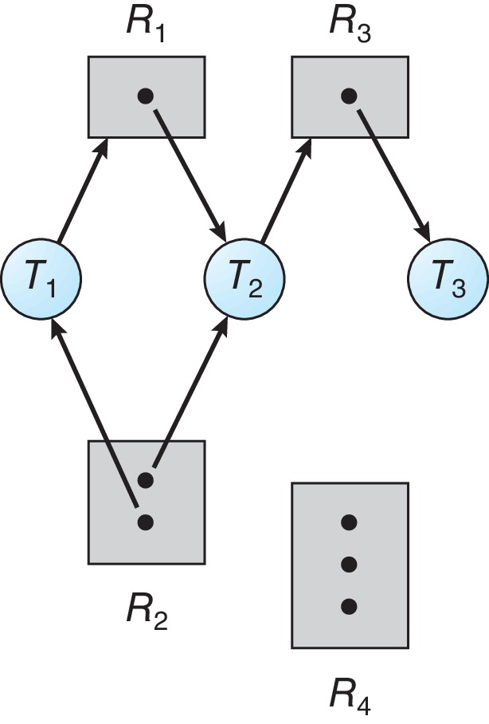
Resource Allocation Graph Example
One instance of R1
Two instances of R2
One instance of R3
Three instance of R4
T1 holds one instance of R2 and is waiting for an instance of R1
T2 holds one instance of R1, one instance of R2, and is waiting for an instance of R3
T3 is holds one instance of R3

Slide 16
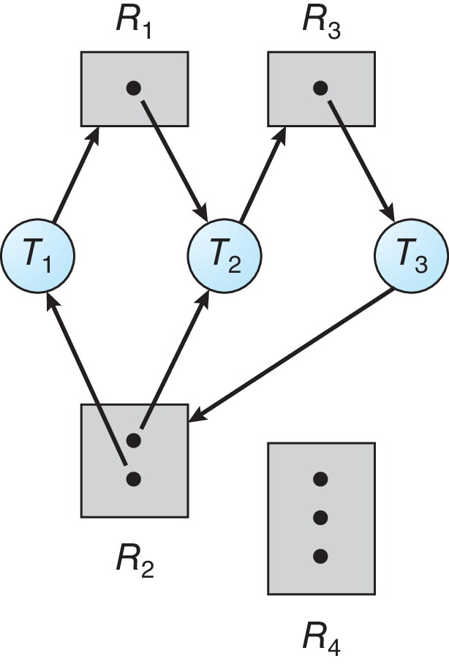
Resource Allocation Graph with a Deadlock

Slide 17
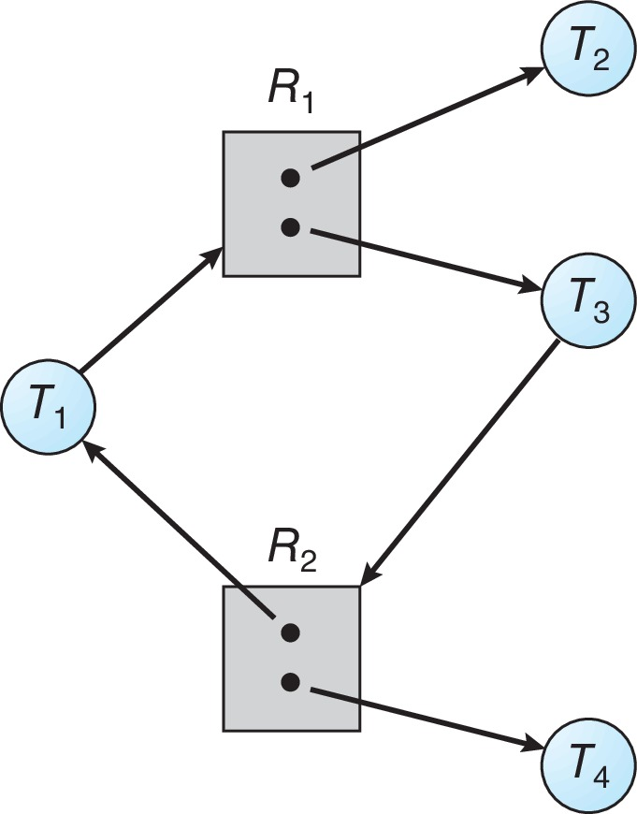
Graph with a Cycle But no Deadlock

Slide 18
Basic Facts
If graph contains no cycles ⇒ no deadlock
If graph contains a cycle ⇒
If only one instance per resource type, then deadlock
If several instances per resource type, possibility of deadlock

Slide 19
Dealing with Deadlock
Three general approaches exist for dealing with deadlock:
Prevent Deadlock
adopt a policy that eliminates one of the conditions
Avoid Deadlock
make the appropriate dynamic choices based on the current state of resource allocation
Detect Recovery
attempt to detect the presence of deadlock and take action to recover
Notes:
Three general approaches exist for dealing with deadlock. First, one can prevent deadlock by adopting a policy that eliminates one of the conditions (conditions 1 through 4). Second, one can avoid deadlock by making the appropriate dynamic choices based on the current state of resource allocation. Third, one can attempt to detect the presence of deadlock (conditions 1 through 4 hold) and take action to recover.

Slide 20
Deadlock Prevention
Invalidate one of the four necessary conditions for deadlock:
Mutual Exclusion – not required for sharable resources (e.g., read-only files); must hold for non-sharable resources
Hold and Wait – must guarantee that whenever a process requests a resource, it does not hold any other resources
Require process to request and be allocated all its resources before it begins execution or allow process to request resources only when the process has none allocated to it.
Low resource utilization; starvation possible

Slide 21
Deadlock Prevention
Invalidate one of the four necessary conditions for deadlock:
No Preemption:
If a process that is holding some resources requests another resource that cannot be immediately allocated to it, then all resources currently being held are released
Preempted resources are added to the list of resources for which the process is waiting
Process will be restarted only when it can regain its old resources, as well as the new ones that it is requesting
Circular Wait:
Impose a total ordering of all resource types, and require that each process requests resources in an increasing order of enumeration

Slide 22
Attacking “circular wait”
Assign an order to resources
Always acquire resources in numerical order
Need not acquire them all at once!
Circular wait is prevented
A process holding resource n can’t wait for resource m if m < n
No way to complete a cycle
Place processes above the highest resource they hold and below any they’re requesting
All arrows point up!
D
C
3
2
B
1
A

Slide 23
Deadlock Avoidance
Requires that the system has some additional a priori information available
Simplest and most useful model requires that each process declare the maximum number of resources of each type that it may need
The deadlock-avoidance algorithm dynamically examines the resource-allocation state to ensure that there can never be a circular-wait condition
Resource-allocation state is defined by the number of available and allocated resources, and the maximum demands of the processes

Slide 24
Safe State
When a process requests an available resource, system must decide if immediate allocation leaves the system in a safe state
System is in safe state if there exists a sequence <P₁, P₂, …, P_{n}> of ALL the processes in the systems such that for each P_{i}, the resources that P_{i} can still request can be satisfied by currently available resources + resources held by all the P_{j}, with j < I
That is:
If P_{i} resource needs are not immediately available, then P_{i} can wait until all P_{j} have finished
When P_{j} is finished, P_{i} can obtain needed resources, execute, return allocated resources, and terminate
When P_{i} terminates, P_{i +1} can obtain its needed resources, and so on

Slide 25
Basic Facts
If a system is in safe state ⇒ no deadlocks
If a system is in unsafe state ⇒ possibility of deadlock
Avoidance ⇒ ensure that a system will never enter an unsafe state.

Slide 26
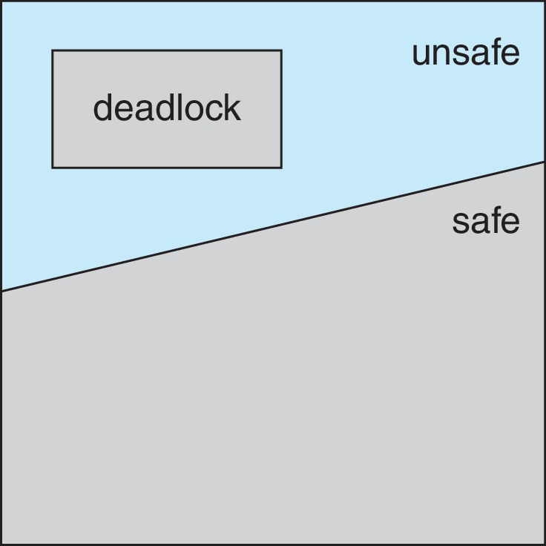
Safe, Unsafe, Deadlock State

Slide 27
Avoidance Algorithms
Single instance of a resource type
Use a modified resource-allocation graph
Multiple instances of a resource type
Use the Banker’s Algorithm

Slide 28
Modified Resource-Allocation Graph Scheme
Claim edge P_{i} --> R_{j} indicates that process P_{i} may request resource R_{j}
Request edge P_{i} → R_{j} indicates that process P_{i} requests resource R_{j}
Claim edge converts to request edge when a process requests a resource
Assignment edge R_{j} → P_{i} indicates that resource R_{j} was allocated to process P_{i}
Request edge converts to an assignment edge when the resource is allocated to the process
When a resource is released by a process, assignment edge reconverts to a claim edge
Resources must be claimed a priori in the system

Slide 29
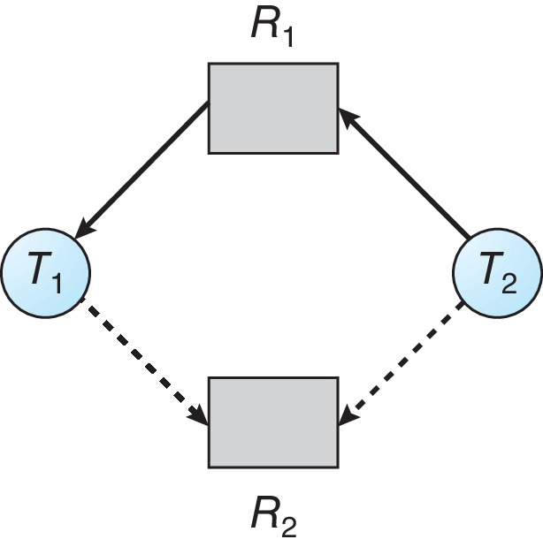
Resource-Allocation Graph

Slide 30
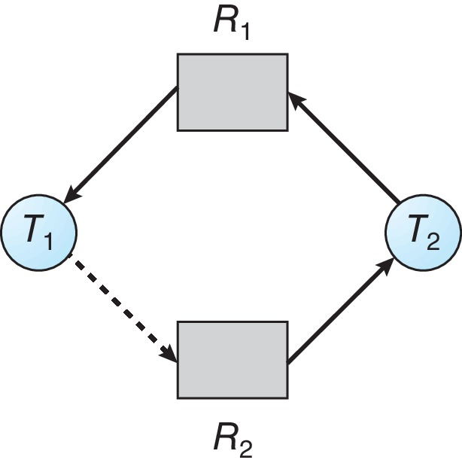
Unsafe State In Resource-Allocation Graph

Slide 31
Resource-Allocation Graph Algorithm
Suppose that process P_{i} requests a resource R_{j}
The request can be granted only if converting the request edge to an assignment edge does not result in the formation of a cycle in the resource allocation graph

Slide 32
Banker’s Algorithm
Multiple instances of resources
Each process must a priori claim maximum use
When a process requests a resource it may have to wait
When a process gets all its resources it must return them in a finite amount of time

Slide 33
Data Structures for the Banker’s Algorithm
Let n = number of processes, and m = number of resources types.
Available: Vector of length m. If available [j] = k, there are k instances of resource type R_{j} available
Max: n x m matrix. If Max [i,j] = k, then process P_{i} may request at most k instances of resource type R_{j}
Allocation: n x m matrix. If Allocation[i,j] = k then P_{i} is currently allocated k instances of R_{j}
Need: n x m matrix. If Need[i,j] = k, then P_{i} may need k more instances of R_{j} to complete its task
Need [i,j] = Max[i,j] – Allocation [i,j]

Slide 34
Safety Algorithm
Let Work and Finish be vectors of length m and n, respectively. Initialize:
Work = Available
Finish [i] = false for i = 0, 1, …, n- 1
Find an i such that both:
(a) Finish [i] = false
(b) Need_{i} ≤ Work
If no such i exists, go to step 4
Work = Work + Allocation_{i} Finish[i] = true go to step 2
If Finish [i] == true for all i, then the system is in a safe state

Slide 35
Resource-Request Algorithm for Process P_{i}
Request_{i} = request vector for process P_{i}. If Request_{i} [j] = k then process P_{i} wants k instances of resource type R_{j}
If Request_{i} ≤ Need_{i} go to step 2. Otherwise, raise error condition, since process has exceeded its maximum claim
If Request_{i} ≤ Available, go to step 3. Otherwise P_{i} must wait, since resources are not available
Pretend to allocate requested resources to P_{i} by modifying the state as follows:
Available = Available – Request_{i};
Allocation_{i} = Allocation_{i} + Request_{i};
Need_{i} = Need_{i} – Request_{i};
If safe ⇒ the resources are allocated to P_{i}
If unsafe ⇒ P_{i} must wait, and the old resource-allocation state is restored

Slide 36
Example of Banker’s Algorithm
5 processes P₀ through P₄;
3 resource types:
A (10 instances), B (5 instances), and C (7 instances)
Snapshot at time T₀:
Allocation Max Available
A B C A B C A B C
P₀ 0 1 0 7 5 3 3 3 2
P₁ 2 0 0 3 2 2
P₂ 3 0 2 9 0 2
P₃ 2 1 1 2 2 2
P₄ 0 0 2 4 3 3

Slide 37
Example (Cont.)
The content of the matrix Need is defined to be Max – Allocation
Need
A B C
P₀ 7 4 3
P₁ 1 2 2
P₂ 6 0 0
P₃ 0 1 1
P₄ 4 3 1

Slide 38
Example (Cont.)
Snapshot at time T₀:
Allocation Max Available Need
A B C A B C A B C A B C
P₀ 0 1 0 7 5 3 3 3 2 7 4 3
P₁ 2 0 0 3 2 2 1 2 2
P₂ 3 0 2 9 0 2 6 0 0
P₃ 2 1 1 2 2 2 0 1 1
P₄ 0 0 2 4 3 3 4 3 1
The system is in a safe state since the sequence < P₁, P₃, P₄, P_{0,}P_{2>} satisfies safety criteria

Slide 39
Example: P₁ Request (1,0,2)
Check that Request ≤ Available (that is, (1,0,2) ≤ (3,3,2) ⇒ true
Allocation Need Available
A B C A B C A B C
P₀ 0 1 0 7 4 3 2 3 0
P₁ 3 0 2 0 2 0
P₂ 3 0 2 6 0 0
P₃ 2 1 1 0 1 1
P₄ 0 0 2 4 3 1
Executing safety algorithm shows that sequence < P₁, P₃, P₄, P₀, P₂> satisfies safety requirement
Can request for (3,3,0) by P₄ be granted?
Can request for (0,2,0) by P₀ be granted?

Slide 40
Example: consider a system with 5 processes (P₀ ... P₄) and 3 resources types (A(10) B(5) C(7))
resource-allocation state at time t₀:
Is the system in a safe state? If so, which sequence satisfies the safety criteria?
< P₁, P₃, P₄, P₂, P₀ >
Now suppose, P₁ requests an additional instance of A and 2 more instances of type C.
request[1] = (1,0,2)
check if request[1] <= need[i] (yes)
check if request[1] <= available[i] (yes)
do pretend updates to the state
Is the system in a safe state? If so, which sequence satisfies the safety criteria?
<P₁, P₃, P₄, P₀, P₂> (The state matrix on the back slide)
Hence, we immediately grant the request.
Will a request of (3,3,0) by P₄ be granted?
Will a request of (0,2,0) by P₀ be granted?

Slide 41
Process | Allocation |  |  | Max |  |  | Need |  |  | Available
 | A | B | C | A | B | C | A | B | C | A | B | C
P₀ | 0 | 1 | 0 | 7 | 5 | 3 | 7 | 4 | 3 | 3 | 3 | 2
P₁ | 2 | 0 | 0 | 3 | 2 | 2 | 1 | 2 | 2
P₂ | 3 | 0 | 2 | 9 | 0 | 2 | 6 | 0 | 0
P₃ | 2 | 1 | 1 | 2 | 2 | 2 | 0 | 1 | 1
P₄ | 0 | 0 | 2 | 4 | 3 | 3 | 4 | 3 | 1

Slide 42
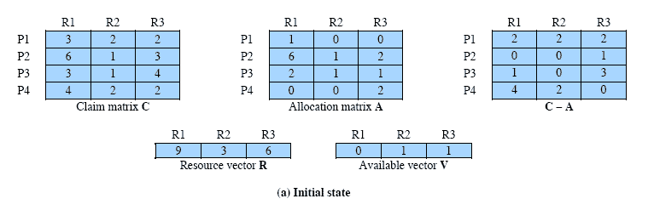
Q1. Determination of a Safe State

Slide 43
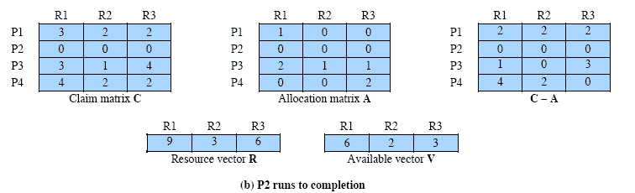
Determination of a Safe State contd

Slide 44
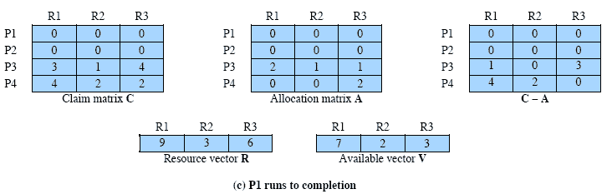
Determination of a Safe State Contd..

Slide 45
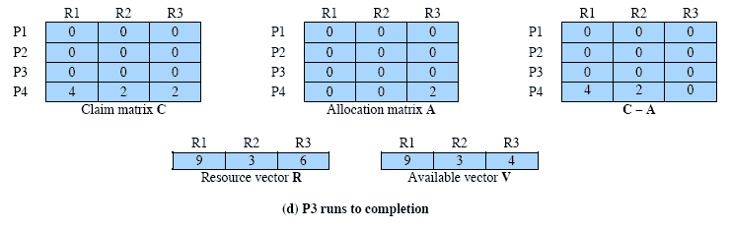
Determination of a Safe State Contd..

Slide 46
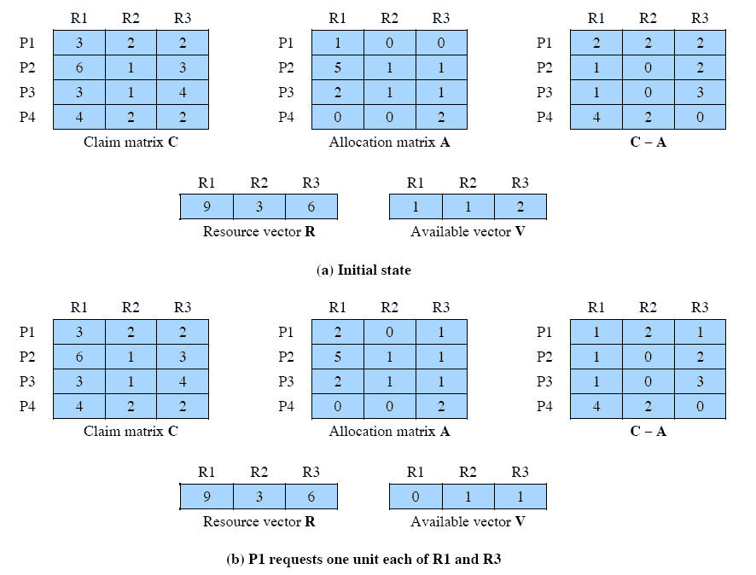
Determination of an Unsafe State Contd..(Solve)

Slide 47
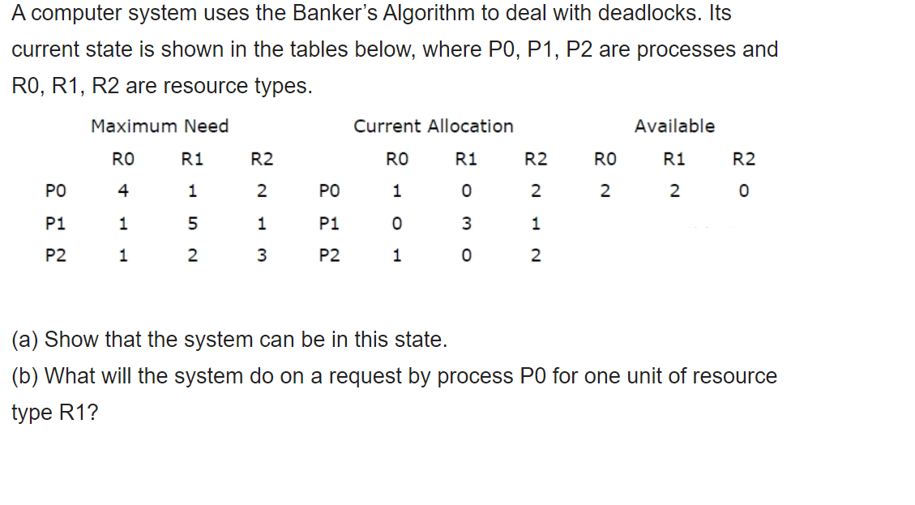

Slide 48
Deadlock Detection
Allow system to enter deadlock state
Detection algorithm
Recovery scheme

Slide 49
Single Instance of Each Resource Type
Maintain wait-for graph
Nodes are processes
P_{i} → P_{j} if P_{i} is waiting for P_{j}
Periodically invoke an algorithm that searches for a cycle in the graph. If there is a cycle, there exists a deadlock
An algorithm to detect a cycle in a graph requires an order of n² operations, where n is the number of vertices in the graph

Slide 50
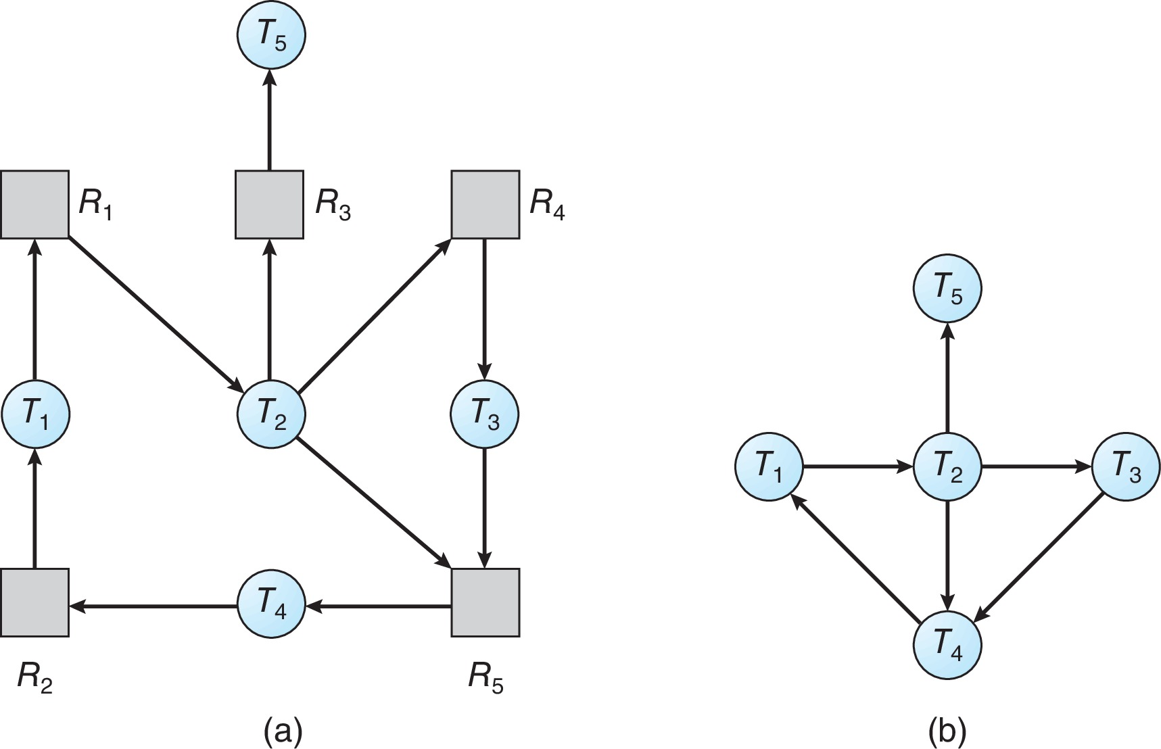
Resource-Allocation Graph and Wait-for Graph
Resource-Allocation Graph
Corresponding wait-for graph

Slide 51
Several Instances of a Resource Type
Available: A vector of length m indicates the number of available resources of each type
Allocation: An n x m matrix defines the number of resources of each type currently allocated to each process
Request: An n x m matrix indicates the current request of each process.
If Request [i][j] = k, then process P_{i} is requesting k more instances of resource type R_{j}.

Slide 52
Detection Algorithm
Let Work and Finish be vectors of length m and n, respectively Initialize:
Work = Available
For i = 1,2, …, n, if Allocation_{i} ≠ 0, then Finish[i] = false; otherwise, Finish[i] = true
Find an index i such that both:
Finish[i] == false
Request_{i} ≤ Work
If no such i exists, go to step 4

Slide 53
Detection Algorithm (Cont.)
Work = Work + Allocation_{i} Finish[i] = true go to step 2
If Finish[i] == false, for some i, 1 ≤ i ≤ n, then the system is in deadlock state. Moreover, if Finish[i] == false, then P_{i} is deadlocked
Algorithm requires an order of O(m x n²) operations to detect whether the system is in deadlocked state

Slide 54
Example of Detection Algorithm
Five processes P₀ through P₄; three resource types A (7 instances), B (2 instances), and C (6 instances)
Snapshot at time T₀:
Allocation Request Available
A B C A B C A B C
P₀ 0 1 0 0 0 0 0 0 0
P₁ 2 0 0 2 0 2
P₂ 3 0 3 0 0 0
P₃ 2 1 1 1 0 0
P₄ 0 0 2 0 0 2
Sequence <P₀, P₂, P₃, P₁, P₄> will result in Finish[i] = true for all i

Slide 55
Example (Cont.)
P₂ requests an additional instance of type C
Request
A B C
P₀ 0 0 0
P₁ 2 0 2
P₂ 0 0 1
P₃ 1 0 0
P₄ 0 0 2
State of system?
Can reclaim resources held by process P₀, but insufficient resources to fulfill other processes; requests
Deadlock exists, consisting of processes P₁, P₂, P₃, and P₄

Slide 56
Detection-Algorithm Usage
When, and how often, to invoke depends on:
How often a deadlock is likely to occur?
How many processes will need to be rolled back?
One for each disjoint cycle
If detection algorithm is invoked arbitrarily, there may be many cycles in the resource graph and so we would not be able to tell which of the many deadlocked processes “caused” the deadlock.

Slide 57
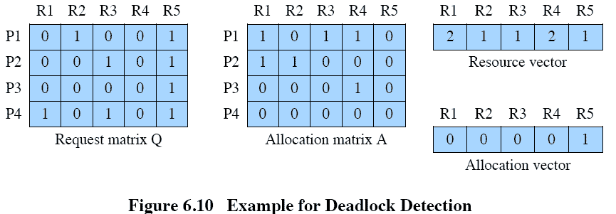
Question: Deadlock Detection (Solve)

Slide 58
Recovery from Deadlock: Process Termination
Abort all deadlocked processes
Abort one process at a time until the deadlock cycle is eliminated
In which order should we choose to abort?
Priority of the process
How long process has computed, and how much longer to completion
Resources the process has used
Resources process needs to complete
How many processes will need to be terminated
Is process interactive or batch?

Slide 59
Recovery from Deadlock: Resource Preemption
Selecting a victim – minimize cost
Rollback – return to some safe state, restart process for that state
Starvation – same process may always be picked as victim, include number of rollback in cost factor

Slide 60
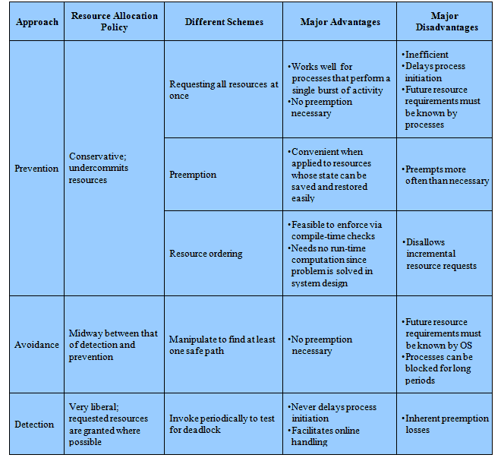
Advantages and Disadvantages

Slide 61
Thank you!!!!
References:
Silberschatz, Abraham, Peter B. Galvin, and Greg Gagne. Operating system concepts with Java. Wiley Publishing, 2009.
Stallings, William. Operating Systems 5th Edition. Pearson Education India, 2006.
Tannenbaum, Andrew S. "Modern Operating Systems, 2009."

